Slide 1
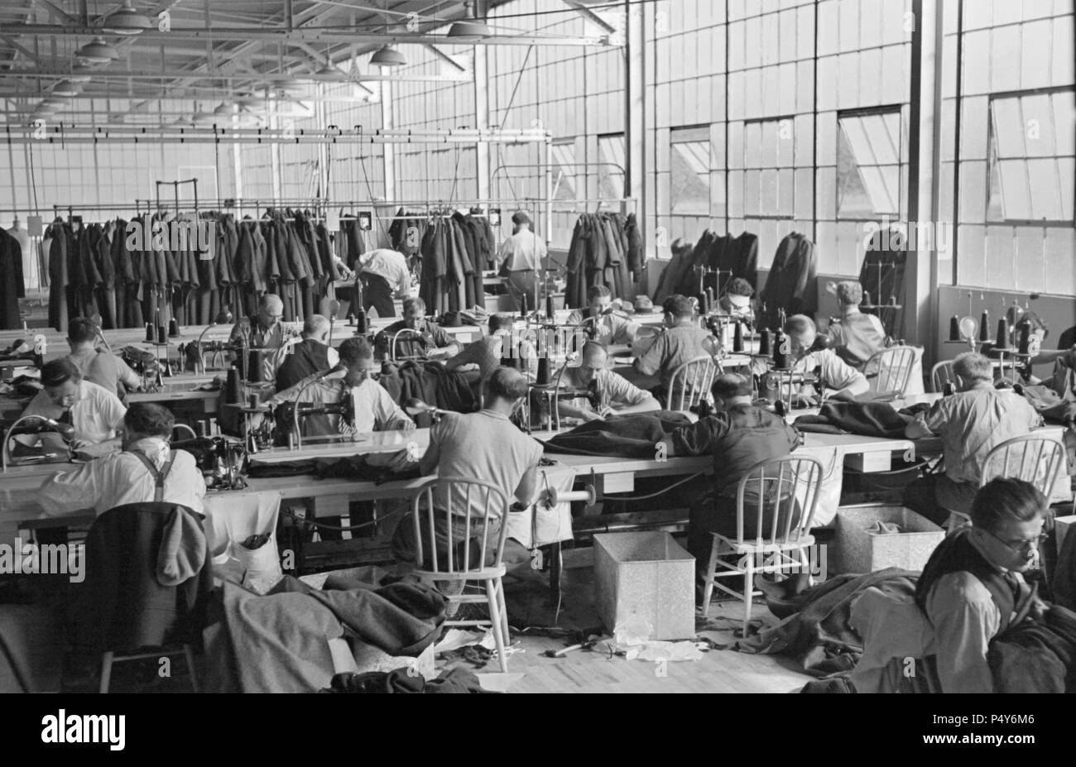
Optimizing Garment Manufacturing: Predicting Employee Productivity with Machine Learning
Name: Erning Xu
Institution: Brown University
Date: 2024/10/25
GitHub: https://github.com/ErningXu/Midterm.git

Slide 2



Introduction
Problem Description
Why is this Important?
Data Collection
Goal: predicting the productivity of garment employees based on various factors
Regression problem
Target variable: employee productivity
Optimizing resource allocation
Improving operational efficiency
Increasing output without sacrificing quality.
Data source: UCI Machine Learning Repository
Data was collected from a garment manufacturing facility in 2015

Slide 3
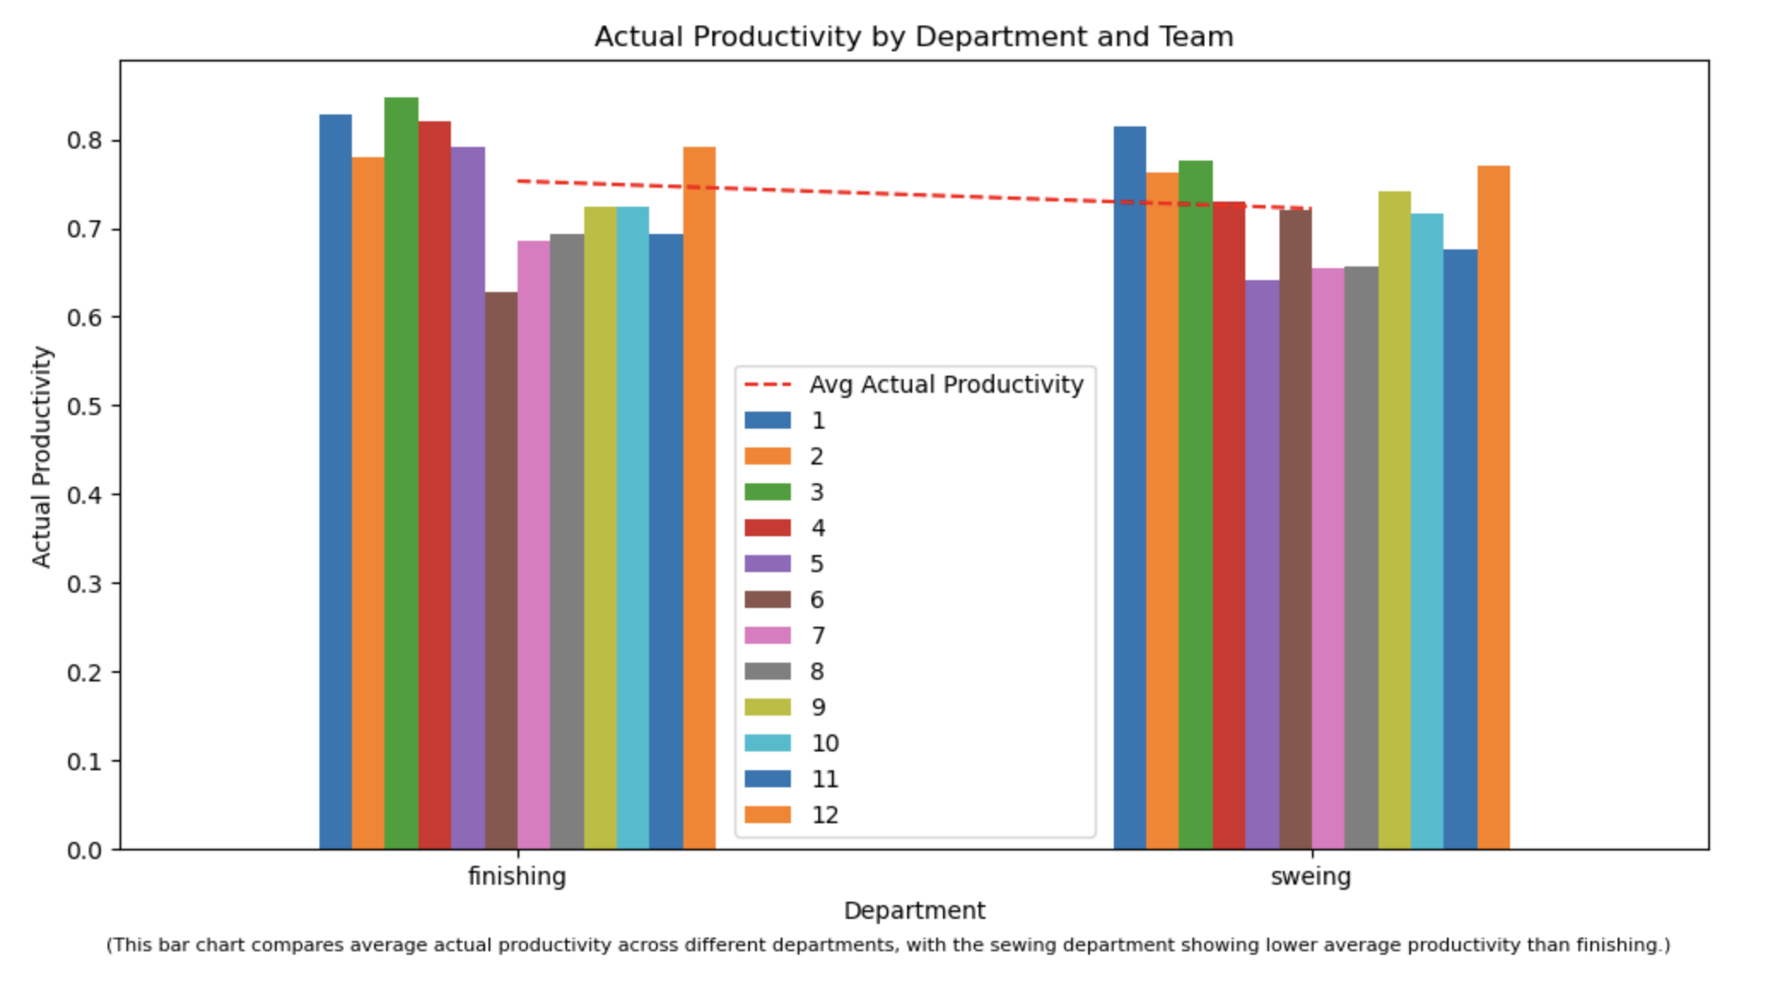
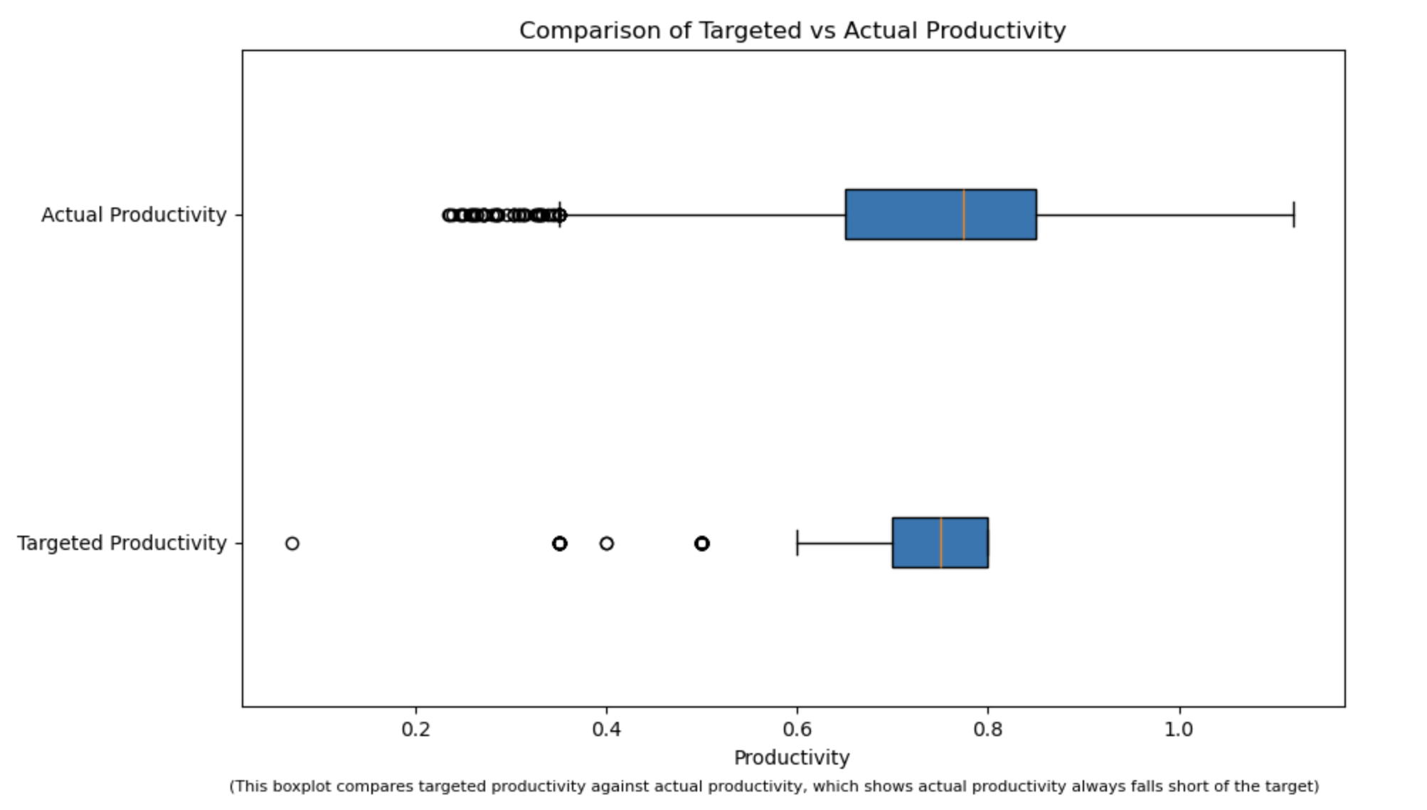
Exploratory Data Analysis

Slide 4
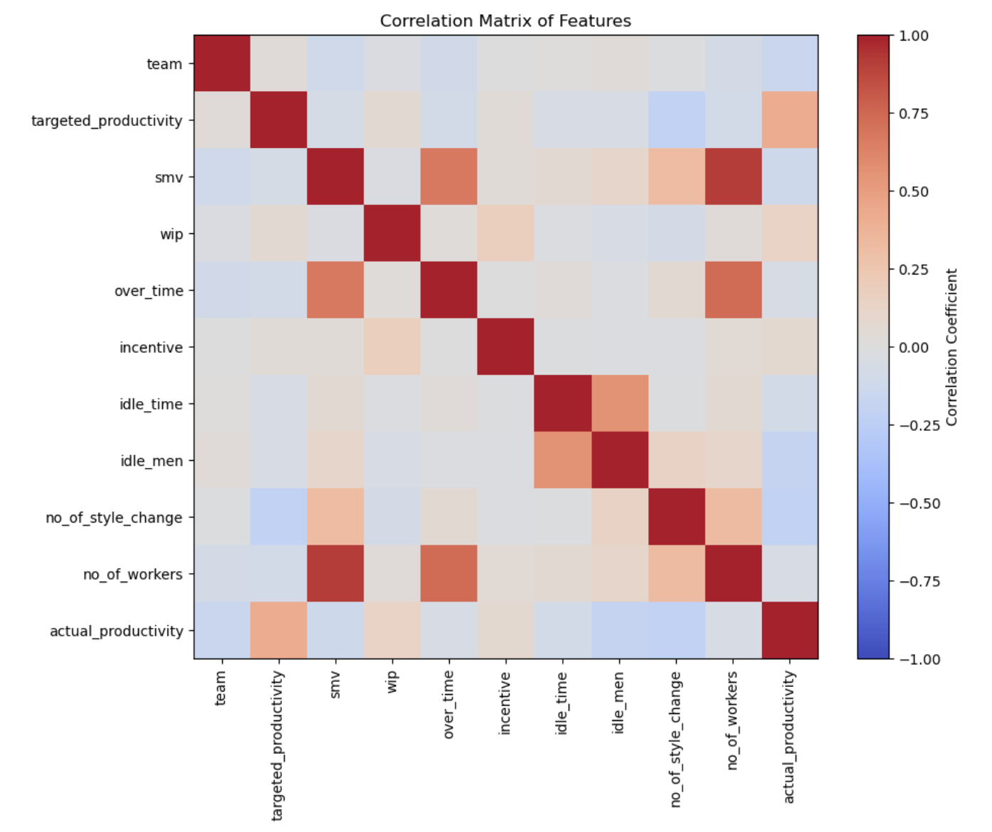
Exploratory Data Analysis

Slide 5
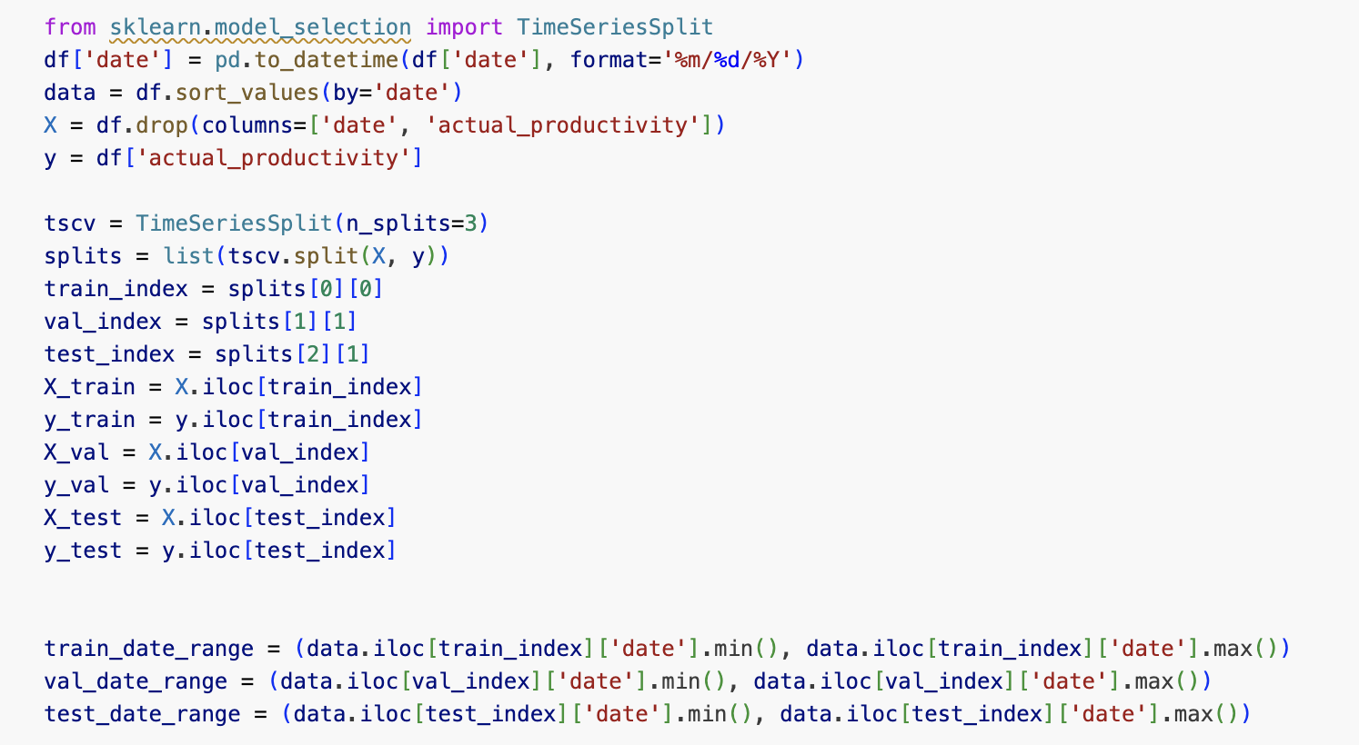
Splitting
Time Series Splitting:
The data is ordered chronologically
Using the earlier data for training and the later data for testing to avoid data leakage.
Train-Test Split:
Training Data: The earlier 70% of the data.
Testing Data: The most recent 30% of the data, which helps evaluate the model's performance on unseen future data.

Slide 6
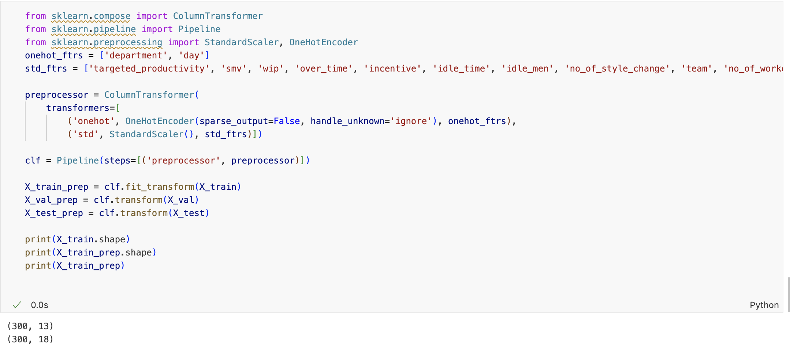
Preprocessing
Handling Categorical Variables:
Categorical features like department, day, and quarter were handled using one-hot encoding.
Standardization:
Numeric features like idle time, SMV (standard minute value), and incentives were scaled using StandardScaler to normalize the data.
Missing Values:
506 missing Continuous Values in wip
Number of Features:
Before Preprocessing: 13
After Preprocessing: 18

